Slide 1
20XD24 - OBJECT ORIENTED PROGRAMMING
Chapter – VII
Exception Handling

Slide 2
Outline
Introduction
Exception Handling
  Try
  Catch
  throw

Slide 3

Introduction
An exception indicates an unusual situation that occurs during a program’s execution
Exception handling enables a program to deal with exceptional situations and continue its normal execution
An exception is an indication of a problem that occurs during a program’s execution. Exception handling enables you to create applications that can resolve (or handle) exceptions
An exception is an occurrence of an undesirable situation that can be detected during program execution
  For example
  division by zero
  trying to open an input file that does not exist

Slide 4
When to use Exception Handling?
Exception handling is designed to process synchronous errors, which occur when a statement executes, such as
  Out-of-range array subscripts
  arithmetic overflow (i.e., a value outside the representable range of values)
  division by zero
  invalid function parameters and
  Unsuccessful memory allocation (due to lack of memory)
Exception handling is not designed to process errors associated with asynchronous events such as
  Disk I/O completions
  Network message arrivals
  mouse clicks and keystrokes
  which occur in parallel with, and independent of, the program’s flow of control

Slide 5
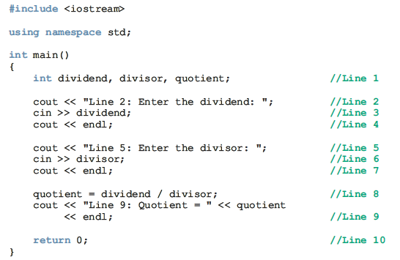

Exception
CPP_Proj1.exe has encountered a problem and needs to close

Slide 6
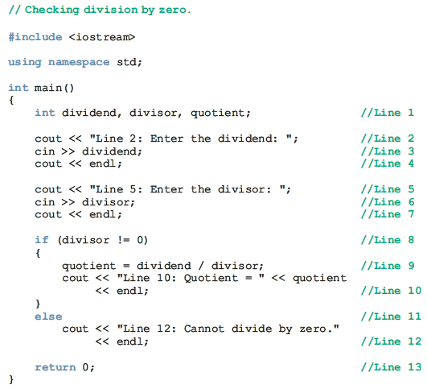
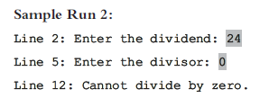
Exception

Slide 7
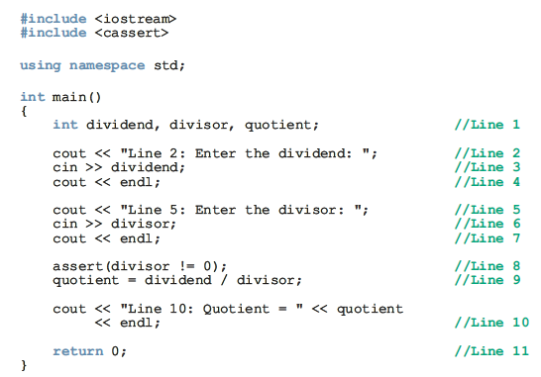
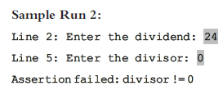
Exception
The following program uses the function assert to determine whether the divisor is zero. If the divisor is zero, the function assert terminates the program with an error message

Slide 8
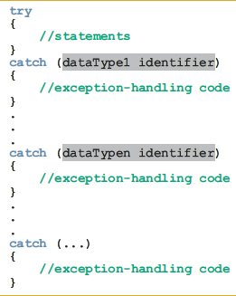
C++ Mechanisms of Exception Handling
try/catch Block
  try - The statements that may generate an exception are placed in a try block. The try block also contains statements that should not be executed if an exception occurs
  catch - The try block is followed by one or more catch blocks. A catch block specifies the type of exception it can catch and contains an exception handler
General syntax of the try/catch block

Slide 9
C++ Mechanisms of Exception Handling
Note
If no exception is thrown in a try block, all catch blocks associated with that try block are ignored and program execution resumes after the last catch block
If an exception is thrown in a try block, the remaining statements in that try block are ignored. The program searches the catch blocks in the order they appear after the try block and looks for an appropriate exception handler. If the type of thrown exception matches the parameter type in one of the catch blocks, the code of that catch block executes, and the remaining catch blocks after this catch block are ignored
The last catch block that has an ellipses (three dots) is designed to catch any type of exception

Slide 10

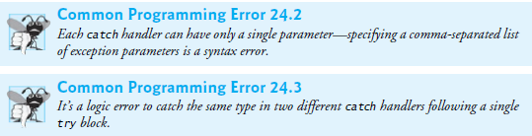
C++ Mechanisms of Exception Handling
Consider the following catch block
In this catch block
  The identifier x acts as a parameter. In fact, it is called a catch block parameter
  The data type int specifies that this catch block can catch an exception of type int
  A catch block can have at most one catch block parameter

Slide 11
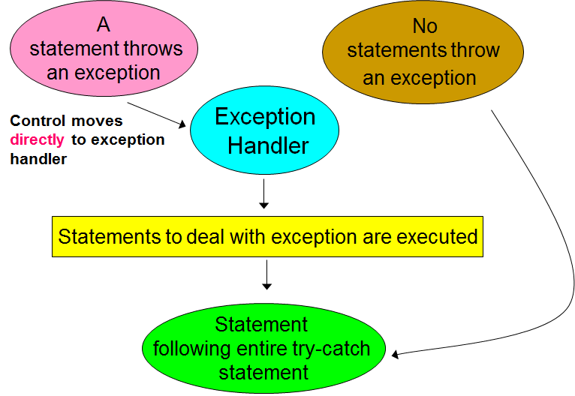
Execution of try-catch

Slide 12
Throwing an Exception
In order for an exception to occur in a try block and be caught by a catch block, the exception must be thrown in the try block
General syntax to throw an exception is
throw expression;
The expression is a constant value, variable, or object. The object being thrown can be either a specific object or an anonymous object
Note : In C++, throw is a reserved word

Slide 13
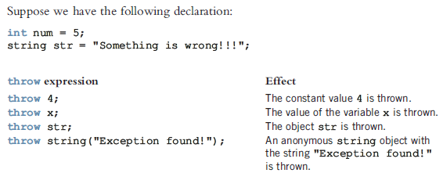
How to use a throw statement?

Slide 14
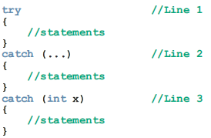
Order of Catch Blocks
A catch block can catch either all exceptions of a specific type or all types of exceptions
The heading of a catch block specifies the type of exception it handles
The catch block that has an ellipses (three dots) is designed to catch any type of exception. Therefore, if we put this catch block first, then this catch block can catch all types of exceptions
For example, consider the following sequence of try/catch blocks
Suppose that an exception is thrown in the try block. Because the catch block in Line 2
can catch exceptions of all types, the catch block in Line 3 cannot be reached
For this sequence of try/catch blocks, some compilers might, in fact, give a syntax error

Slide 15
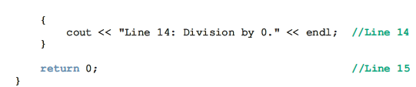
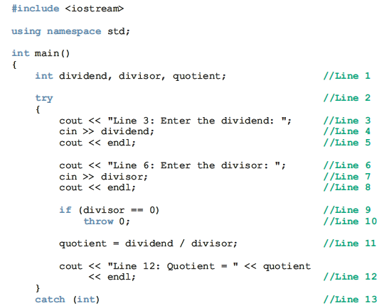
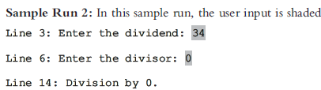
Order of Catch Blocks
Note : In a sequence of try/catch blocks, if the catch block with an ellipses (in the heading) is needed, then it should be the last catch block of that sequence

Slide 16
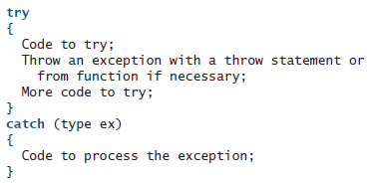


Note
A template for a try-throw-catch block may look like the following
If you are not interested in the contents of an exception object, the catch block parameter may be omitted. For example, the following catch block is legal

Slide 17
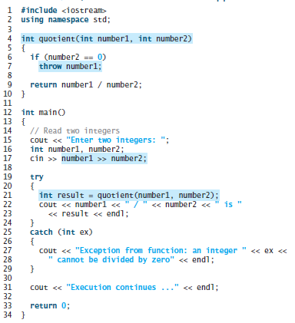

Exception Handling

Slide 18
Rethrowing an Exception
It’s possible that an exception handler, upon receiving an exception, might decide either that it cannot process that exception or that it can process the exception only partially
In such cases, the exception handler can defer the exception handling (or perhaps a portion of it) to another exception handler
In either case, you achieve this by rethrowing the exception via the statement
throw;
Regardless of whether a handler can process an exception, the handler can rethrow the exception for further processing outside the handler
The next enclosing try block detects the rethrown exception, which a catch handler listed after that enclosing try block attempts to handle

Slide 19
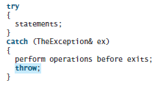

Rethrowing an Exception
After an exception is caught, it can be rethrown to the caller of the function

Slide 20
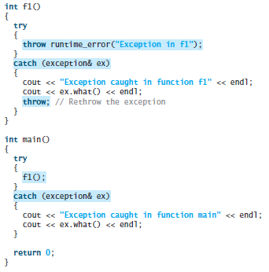

Rethrowing an Exception

Slide 21
Exception Specification
We can declare potential exceptions a function may throw in the function header
An exception specification, also known as throw list, lists exceptions that a function can throw
So far, we have seen the function defined without a throw list. In this case, the function can throw any exception
Syntax for exception specification
returnType functionName(parameterList) throw (exceptionList)
The exceptions are declared in the function header

Slide 22
Exception Specification
A function can declare exception specifications:
  void f() throw (E1, E2, E3);
  declares that function f() may throw any of E1, E2, or E3
  void f() throw()
  declares that no exceptions are thrown in f
  void f()
  declares that any type exception may be thrown in f

Slide 23
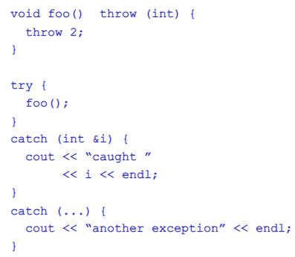
Exception Specification

Slide 24
Using C++ Exception Classes
C++ provides support to handle exceptions via a hierarchy of classes
The class exception is the base of the classes designed to handle exceptions
Among others, this class contains the function what(). The function what returns a string containing an appropriate message
All derived classes of the class exception override the function what() to issue their own error messages
Two classes are immediately derived from the class exception: logic_error and runtime_error - Both of these classes are defined in the header file stdexcept

Slide 25
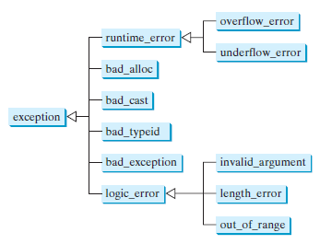
Exception Classes
C++ provides a number of standard classes that can be used for creating exception objects. These classes are shown in the following figure

Slide 26
Exception Classes
The runtime_error class (defined in header <stdexcept>) is a base class for several standard exception classes that describes runtime errors
  Class overflow_error describes an arithmetic overflow—i.e., a value is too large to be stored
  Class underflow_error describes an arithmetic underflow—i.e., a value is too small to be stored
The logic_error class (defined in header <stdexcept>) is a base class for several standard exception classes that describes logic errors
  Class invalid_argument indicates that an invalid argument has been passed to a function
  Class length_error indicates that an object’s length has exceeded the maximum allowed length
  Class out_of_range indicates that a value has exceeded its allowed range

Slide 27
Exception Classes
Classes bad_alloc, bad_cast, bad_typeid, and bad_exception describe the exceptions thrown by C++ operators
For example
A bad_alloc exception is thrown by the new operator if the memory cannot be allocated
A bad_cast exception is thrown by the dynamic_cast operator as the result of a failed cast to a reference type
A bad_typeid exception is thrown by the typeid operator when the operand for typeid is a NULL pointer
The bad_exception class is used in the exception-specification of a function

Slide 28
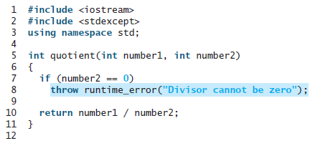
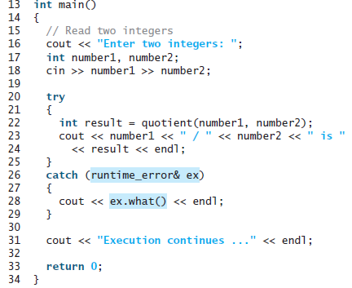

Exception Classes
We can also use these classes to throw exceptions in your programs

Slide 29
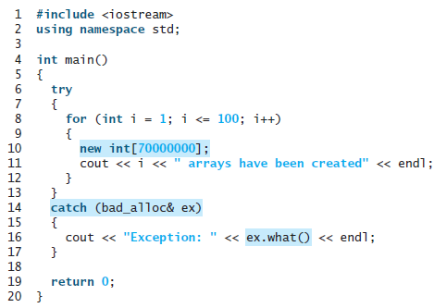
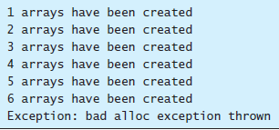
Exception Classes
The following program shows an example of handling the bad_alloc exception

Slide 30
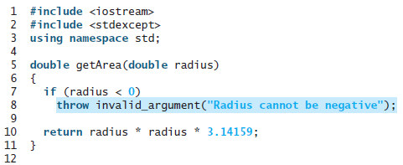
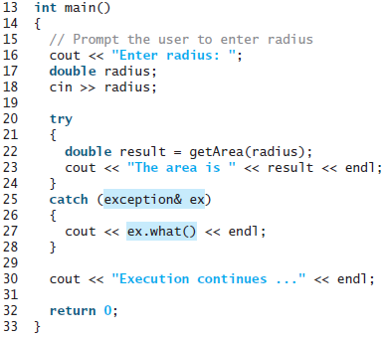

Exception Classes
An example of throwing and handling an invalid_argument exception

Slide 31
Creating Your Own Exception Classes
C++ enables programmers to create their own exception classes to handle both the exceptions not covered by C++’s exception classes and their own exceptions
In C++, any class can be considered an exception class. Therefore, an exception class is simply a class. It need not be inherited from the class exception
The exception class that you define can be very simple in the sense that it does not contain any members
For example, the following code can be considered an exception class
class dummyExceptionClass
{
};

Slide 32
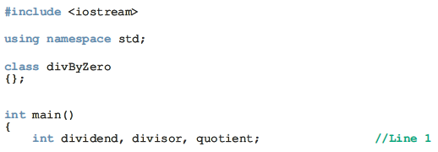
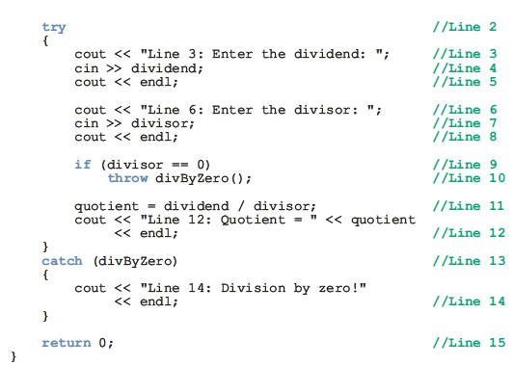
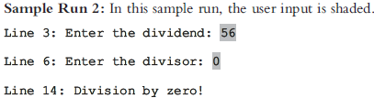
User-defined Exception Class

Slide 33
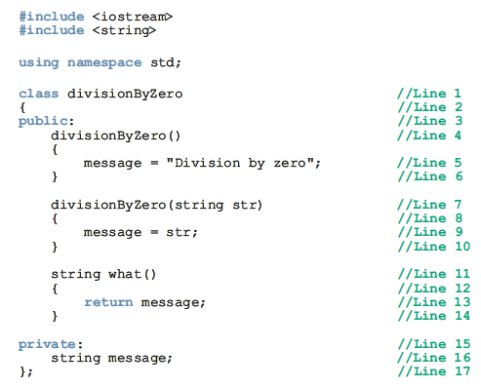
User-defined Exception Class
User-defined exception class divisionByZero with default error message

Slide 34

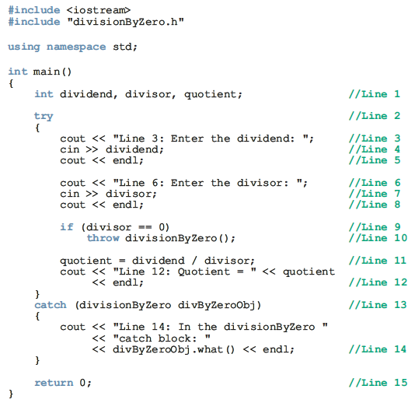
User-defined Exception Class

Slide 35
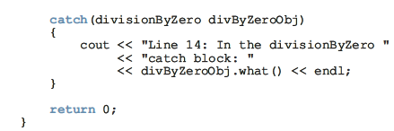
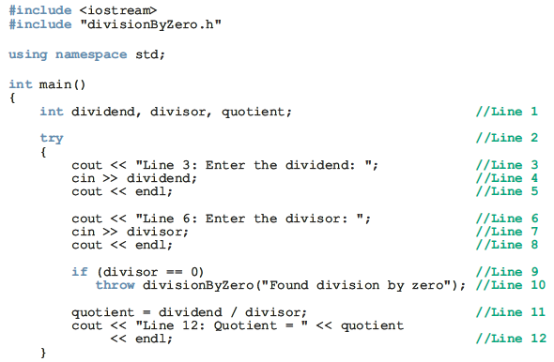

User-defined Exception Class
user-defined exception class divisionByZero with a specific error message

Slide 36
Stack Unwinding
When an exception is thrown in, say, a function, the function can do the following:
  Do nothing
  Partially process the exception and throw the same exception or a new exception
  Throw a new exception
In each of these cases, the function-call stack is unwound so that the exception can be caught in the next try/catch block
When the function call stack is unwound, the function in which the exception was not caught and/or rethrown terminates, and the memory for its local variables is destroyed
The stack unwinding continues until either a try/catch handles the exception or the program does not handle the exception
If the program does not handle the exception, then the function terminate is called to terminate the program

Slide 37

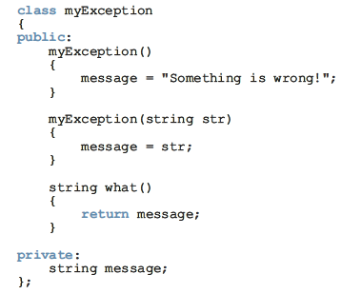
Stack Unwinding

Slide 38
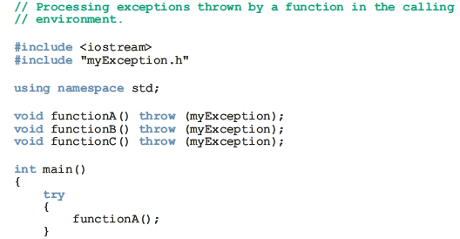

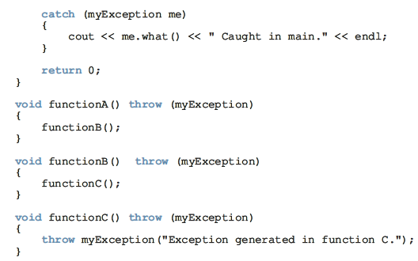
Stack Unwinding

Slide 39

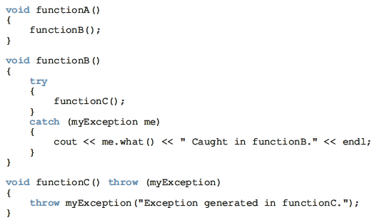
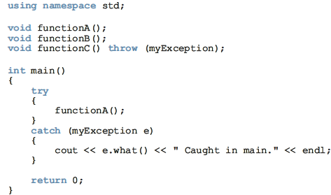
Stack Unwinding
The exception is caught and processed by the immediate calling environment

Slide 40
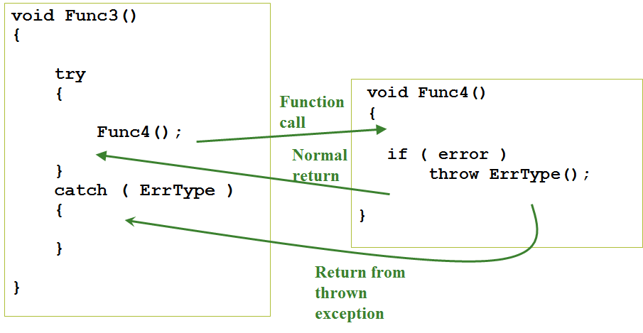
Throwing an Exception to be Caught by the Calling Code

Slide 41
Uncaught Exceptions
If none of the catch handlers for a try block matches a thrown exception, the exception moves to the next enclosing try block.
If there is no match in any enclosing try block the exception is uncaught.
An uncaught exception also occurs if a new exception is thrown before an existing one is handled
If an exception is uncaught the special function terminate() is called
Uncaught exceptions can always be avoided by enclosing the contents of main in a try block with an ellipsis handler

Slide 42
Specification Violations
If an exception specification is violated, the special function unexpected() is called when the exception is thrown
By default unexpected() terminates execution. However, you may change that behavior by defining your own:
void FreddyKrueger() { … }
int main()
{
set_unexpected(FreddyKrueger);
:
}

